Slide 1

NLP Chatbot Development using Dialog flow

Slide 2
Group Members Introduction
Name: Hassam Khan
VU ID: BC210414987

Slide 3
INTRODUCTION OF PROJECT
In today’s fast-moving digital world, restaurants need smarter ways to serve customers quickly and effectively. Chatbots have become a powerful solution, offering 24/7 support and instant replies. This project focuses on building an intelligent restaurant chatbot using Google Dialogflow.
The chatbot is designed to make customer interactions friendly and engaging. It will handle everyday tasks such as making reservations, placing orders, checking order status, and showing the menu. By automating these services, it saves valuable time for both customers and staff.
Along with these basics, the chatbot will also share product details, answer common questions, and help with order confirmations or changes. Customers can even share their feedback directly through the chatbot. These features create a smooth and personalized dining experience.
Overall, the restaurant chatbot aims to boost customer satisfaction while making restaurant operations more efficient. By combining natural language processing with backend integration, this project delivers a practical solution. It not only helps businesses but also gives hands-on experience with AI technologies.

Slide 4
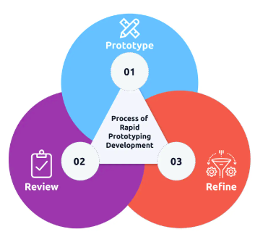
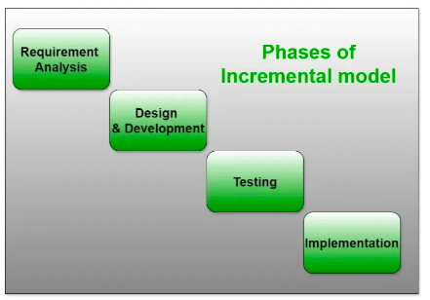
Rapid Prototype Model Incremental Model

Slide 5
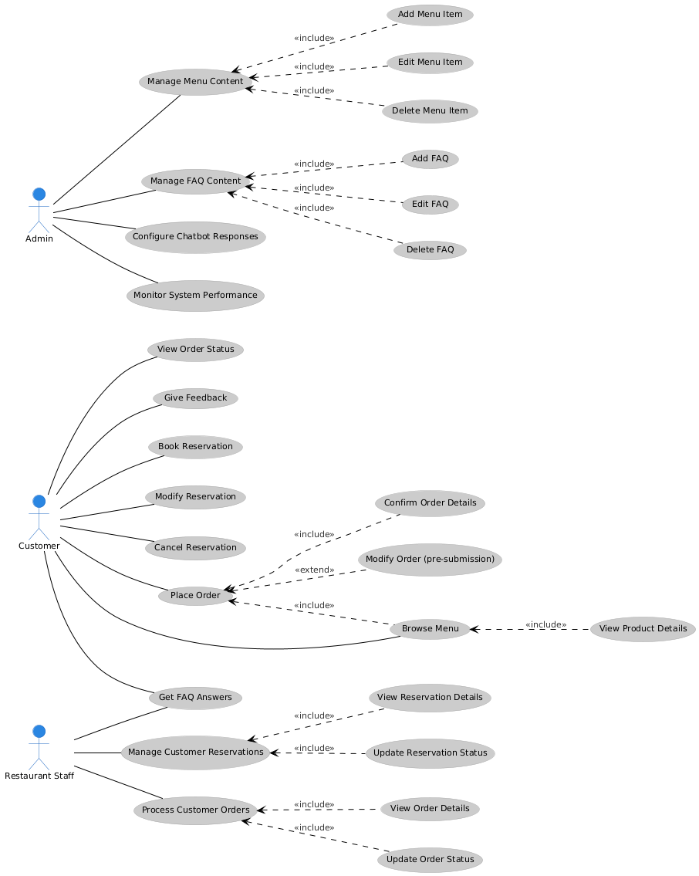
Use Case Diagram

Slide 6
Business Rules Catalog
The goal of this project is to build an AI-powered restaurant chatbot that understands customer requests and communicates in a natural, friendly way. Using Dialogflow, the chatbot will make dining and ordering more convenient for customers while reducing staff workload.
Restaurants often face busy hours, long waiting times, and repeated customer questions. A chatbot can help solve these issues by taking orders, managing reservations, and quickly answering menu-related queries.
Customers usually wait to place orders, ask about menu items, or confirm their bookings. This often leads to slower service and added stress for staff. The chatbot will reduce these challenges by giving instant responses and automating routine tasks.
The chatbot will handle tasks like booking tables, showing the menu, placing or modifying orders, and checking order status. It will also answer FAQs, share product details, and collect customer feedback. The aim is to make customer service smooth, fast, and enjoyable.

Slide 7
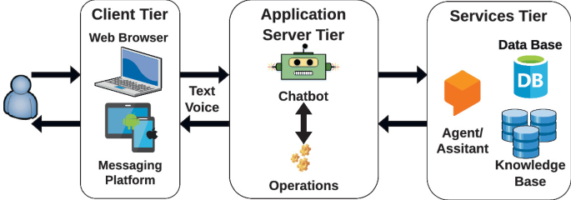
Architectural Design

Slide 8
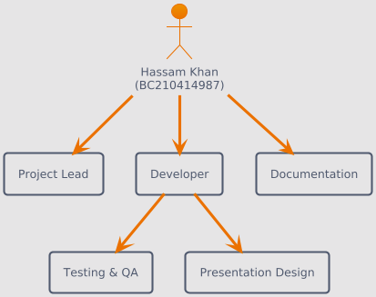
Team Structure

Slide 9
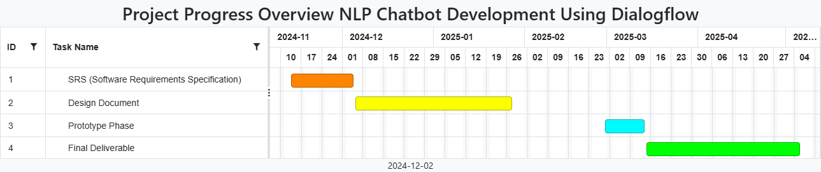
Project Schedule

Slide 10
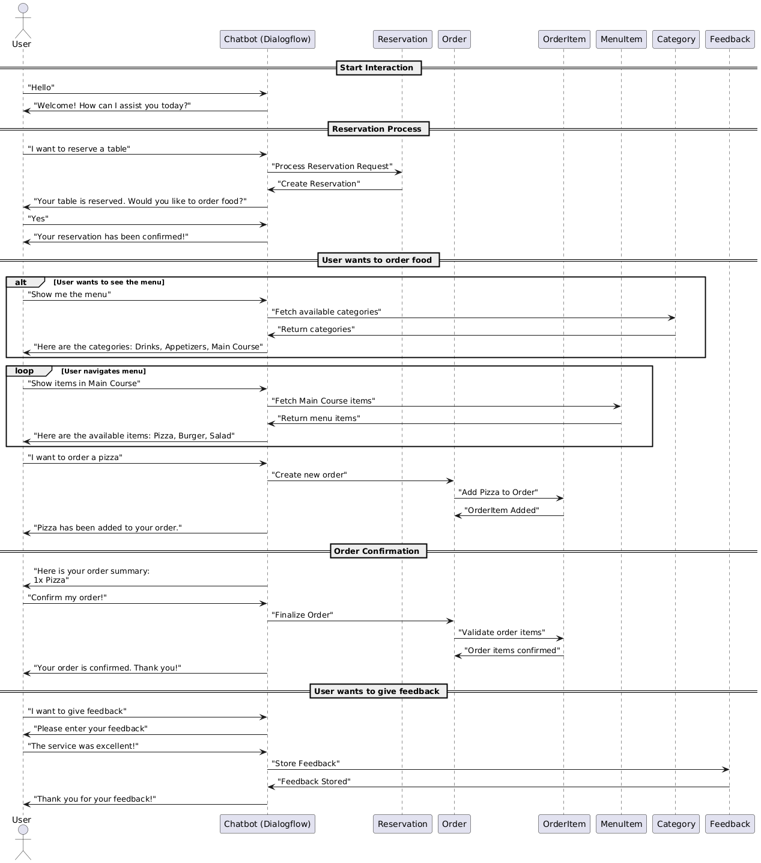
Sequence Diagrams

Slide 11
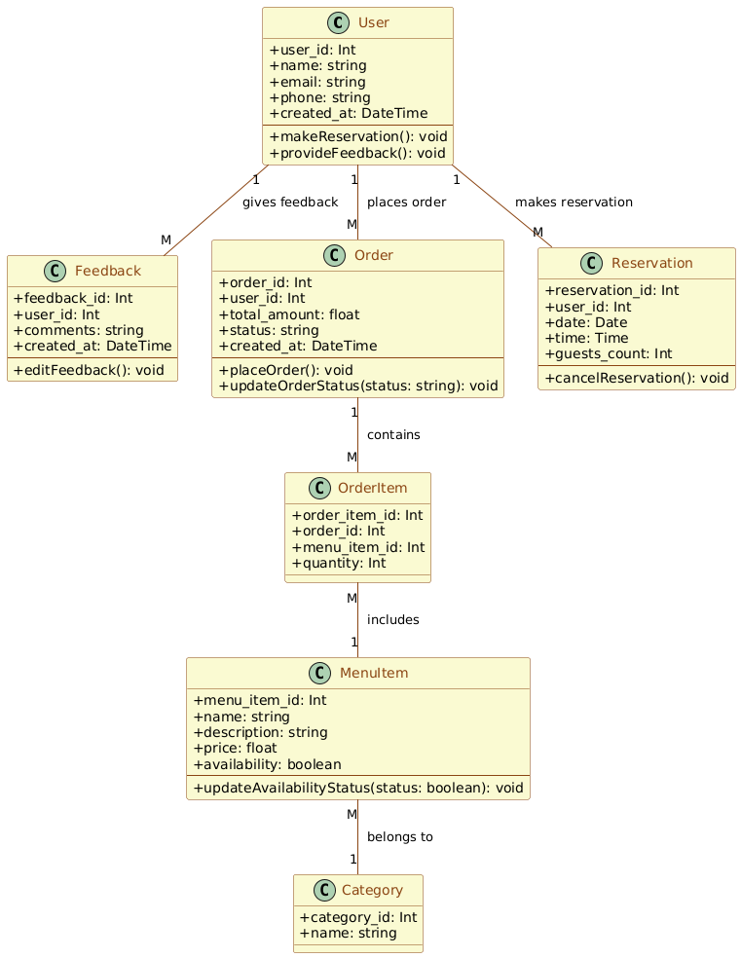
Logical Model/Class Diagram

Slide 12
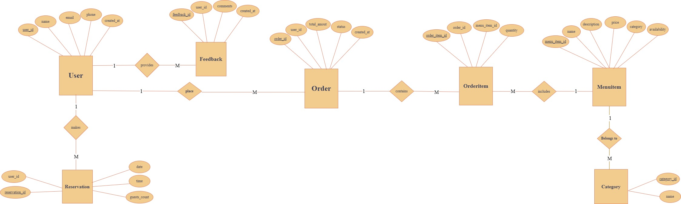
Entity-Relationship Diagram

Slide 13
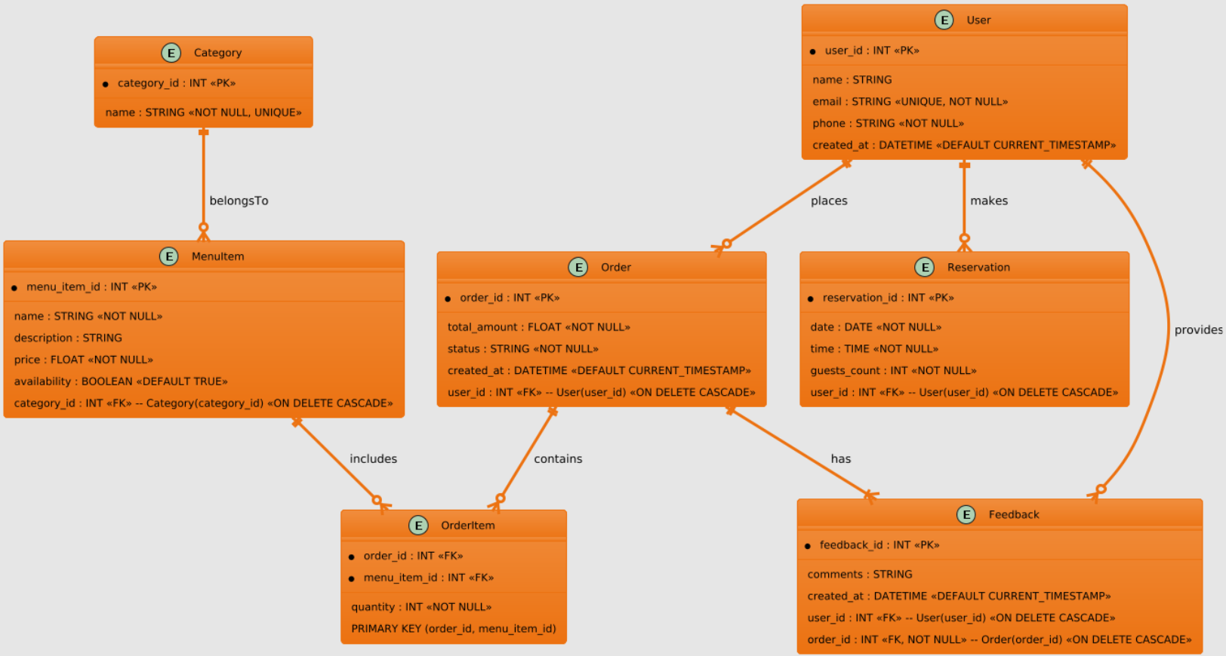
Database Diagram

Slide 14
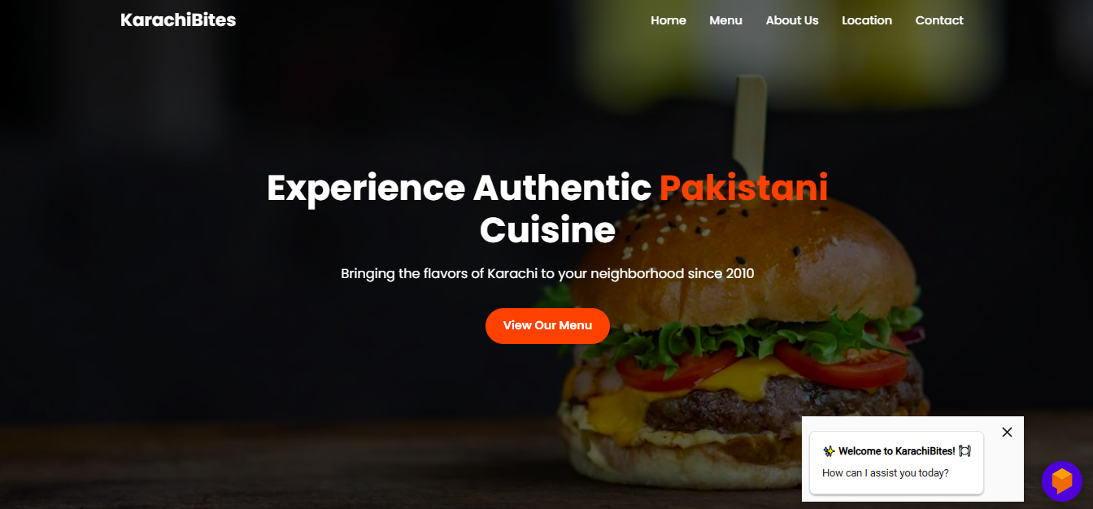
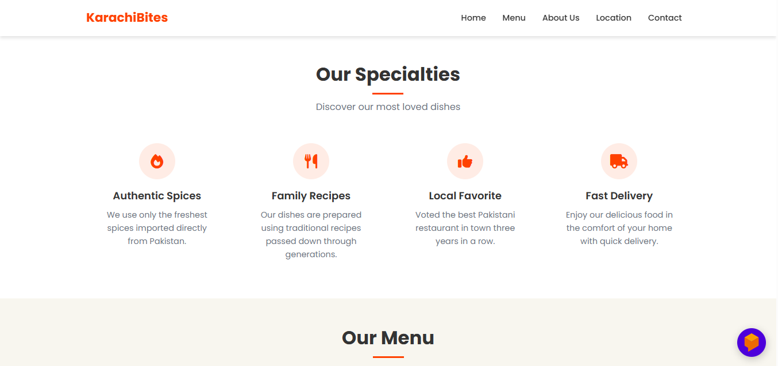
User Interfaces

Slide 15
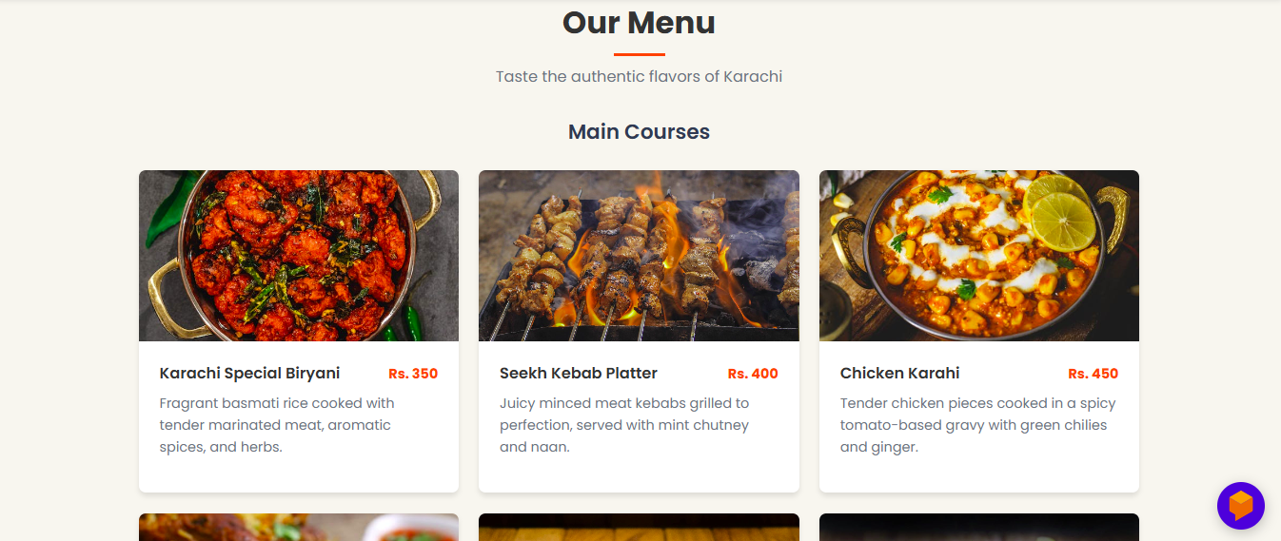

Slide 16
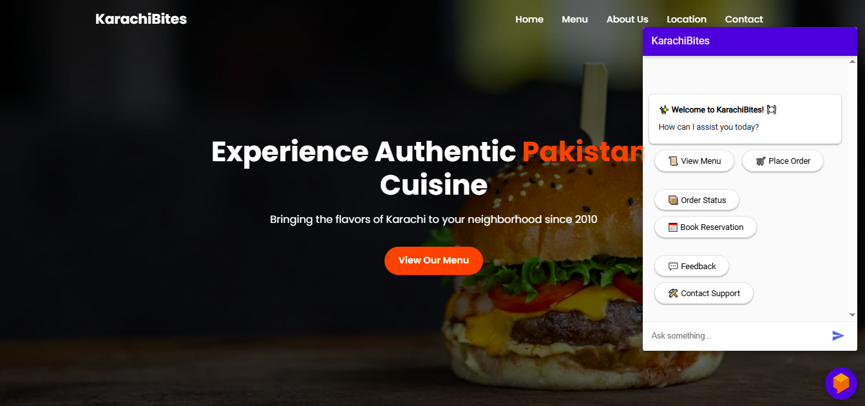
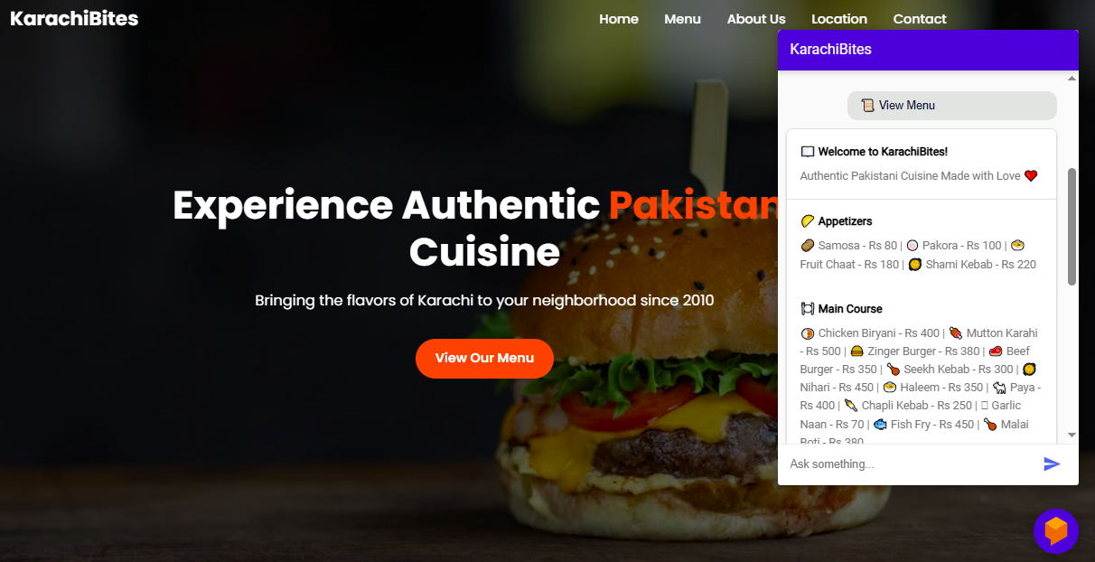

Slide 17
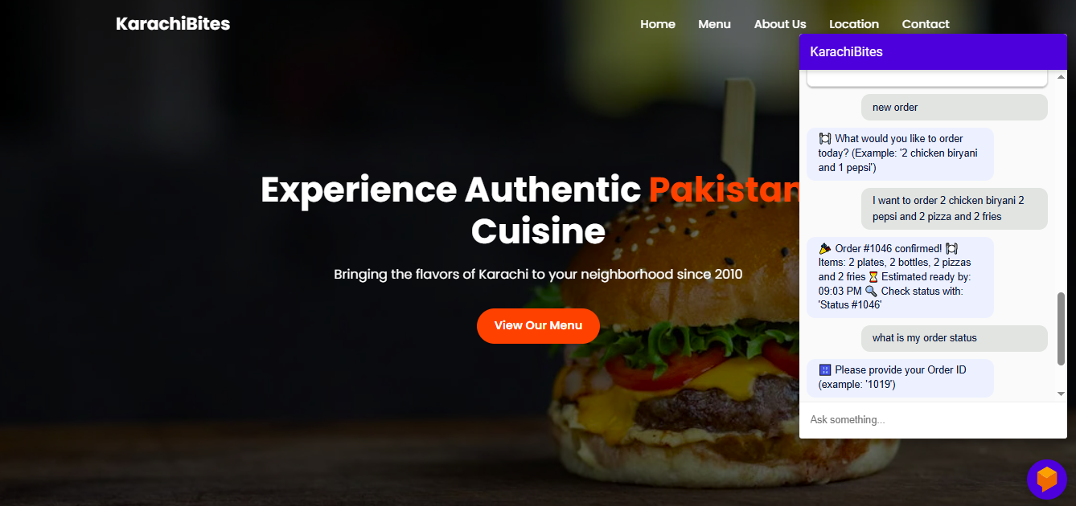
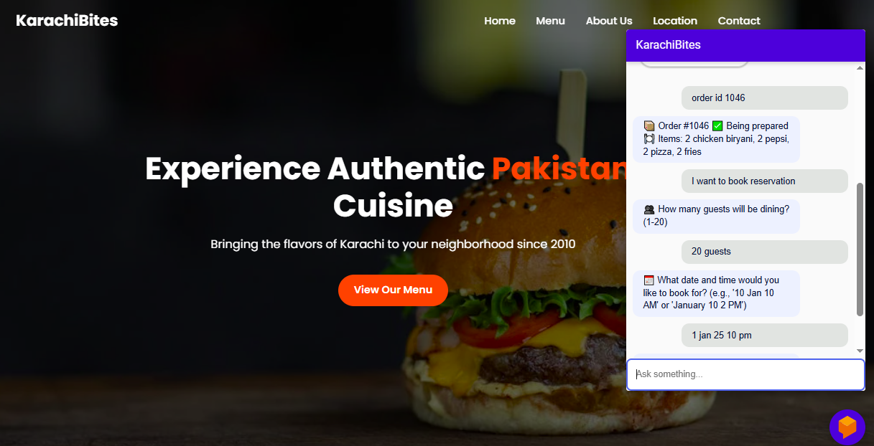

Slide 18
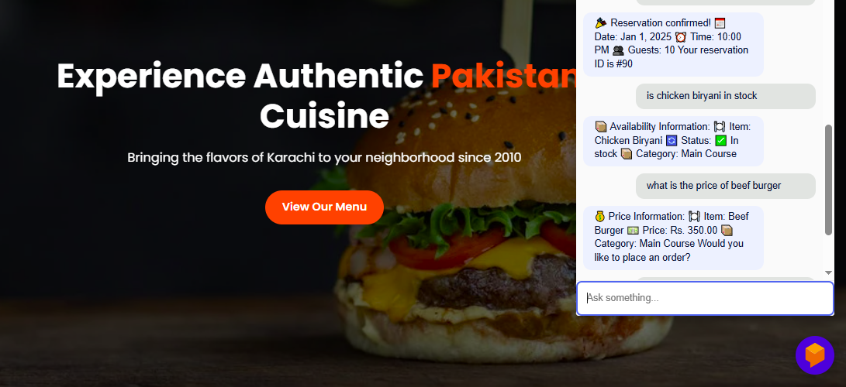
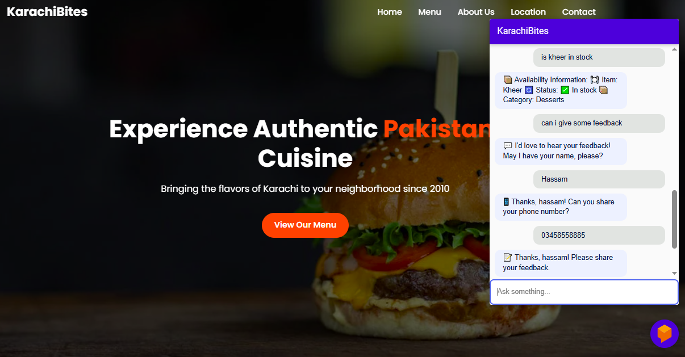

Slide 19
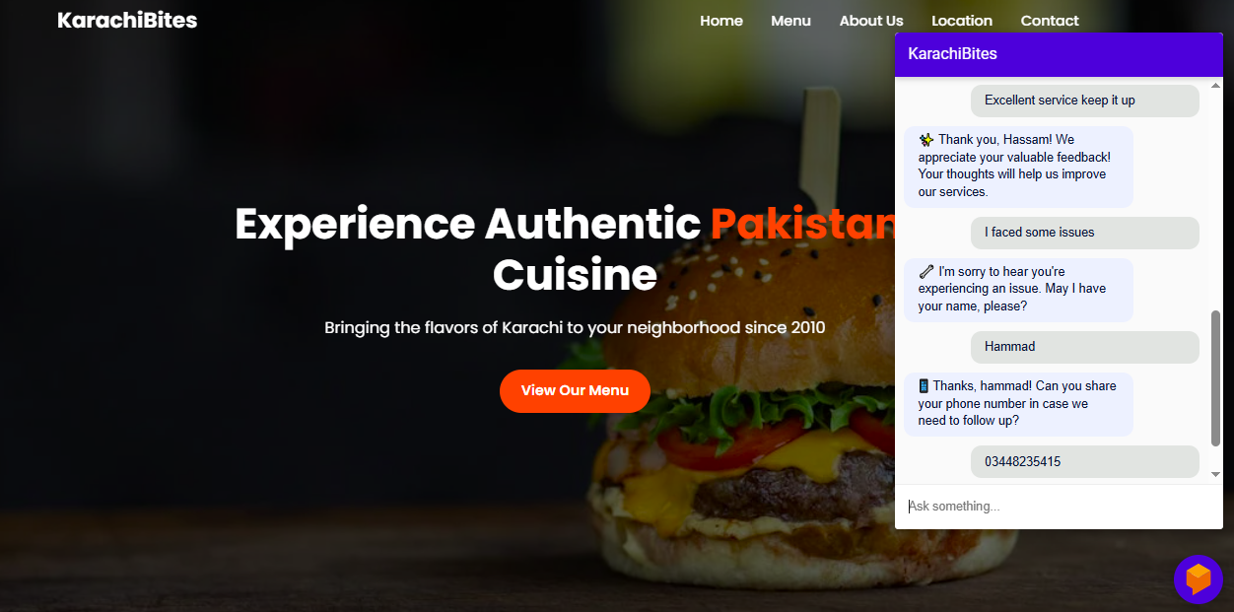
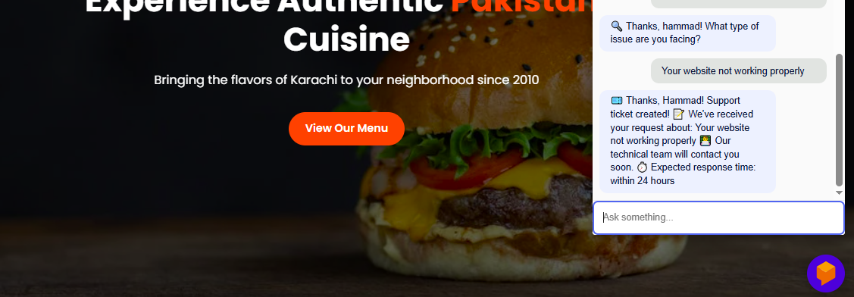

Slide 20
Tools
Google Dialogflow
Python
Fast Api
MySQL
HTML
CSS
JavaScript
Ngrok
Visual Studio Code

Slide 21
A chatbot is not just a tool, it’s the new waiter of the digital age — always ready to serve with speed and a smile.

Slide 22
Thank You

